Slide 1
Model used
There are three resunet ++ model we have trained to segment nodules from 2d slice along coronal, segitial, and axial view.
All of three have same architecture and inputs.
2d ROI
Dual encoder Resunet ++
Segmented mask
Slice + MIPs forward + MIPs backward

Slide 2
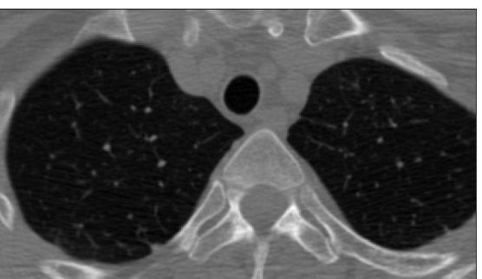
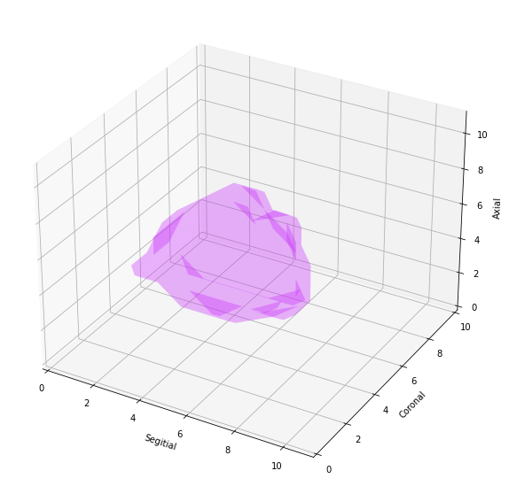

Slide 3
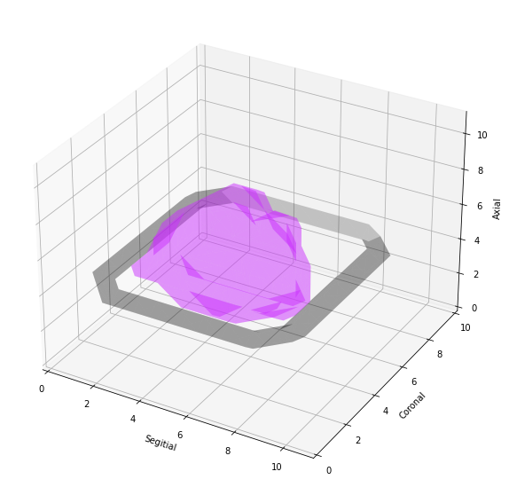
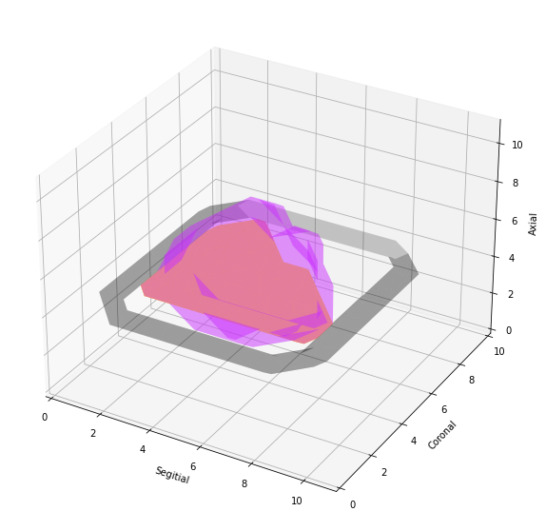
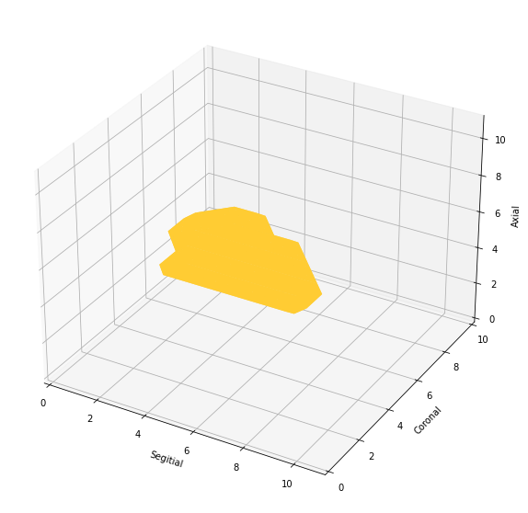
User provide ROI in central slice
After getting ROI 2d mask for nodule is extracted for given ROI

Slide 4
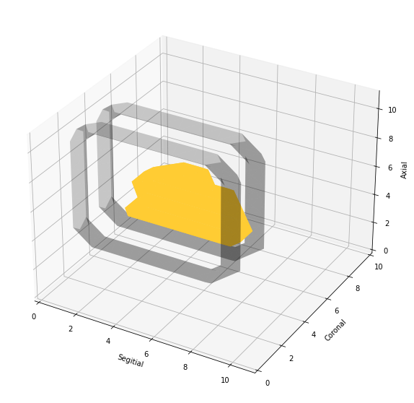
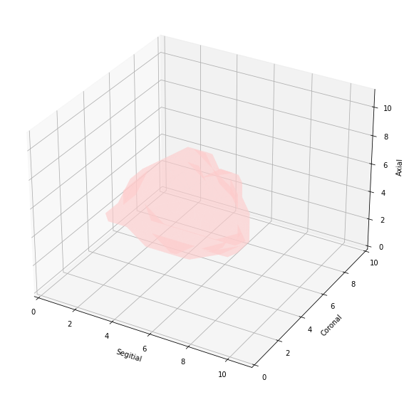
Coronal ROI and mask extraction
Extracted 2d mask is use to generate ROIs in coronal view.
ROI on every slice of coronal is roughly drawn around 2d mask
Using these ROIs a 3d mask is generated. This 3d mask is extracted from coronal ROIs

Slide 5
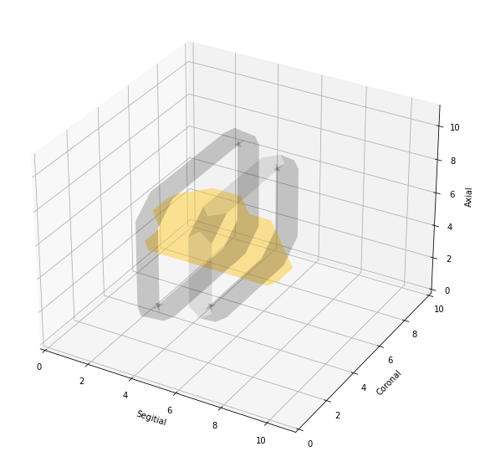
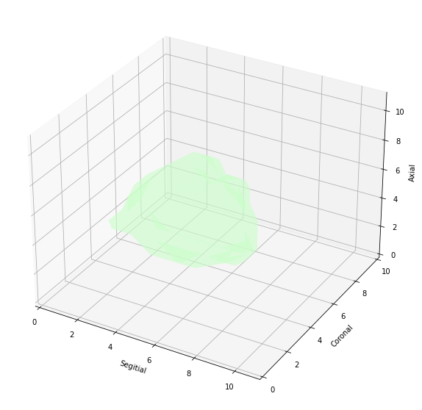
Segitial ROI and mask extraction
Extracted 2d mask is use to generate ROIs in sagittal view.
ROI on every slice of sagittal is roughly drawn around 2d mask
Using these ROIs a 3d mask is generated. This 3d mask is extracted from sagittal ROIs

Slide 6
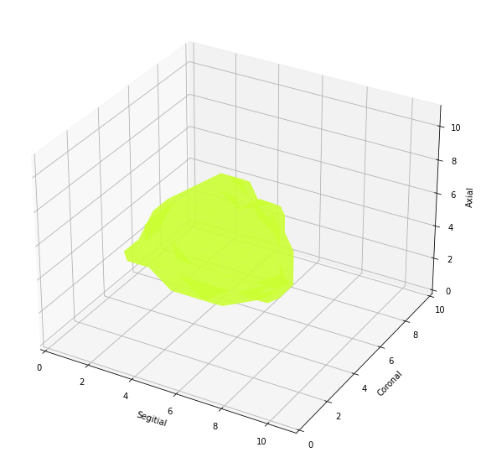
Combining sagittal and coronal mask
Finally both 3d mask are combined to get a 3d mask

Slide 7
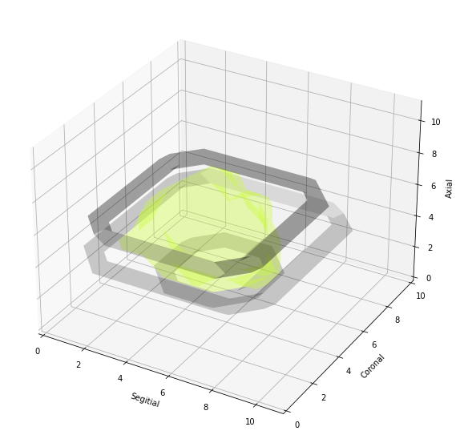
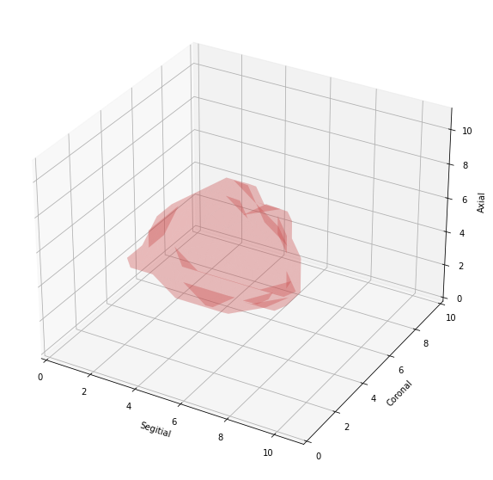
Axial ROI and mask extraction
Axial ROIs are draws on this 3d combined mask and an axial 3d mask for nodule is generated.

Slide 8
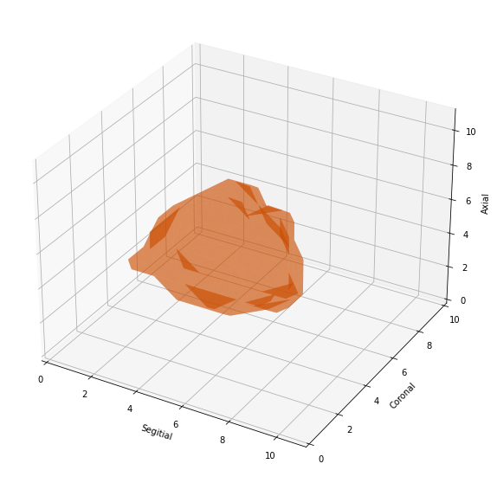
Combining 3 masks to get a final mask
Finally coronal sagittal and axial masks are combined to form a final mask

